Slide 1
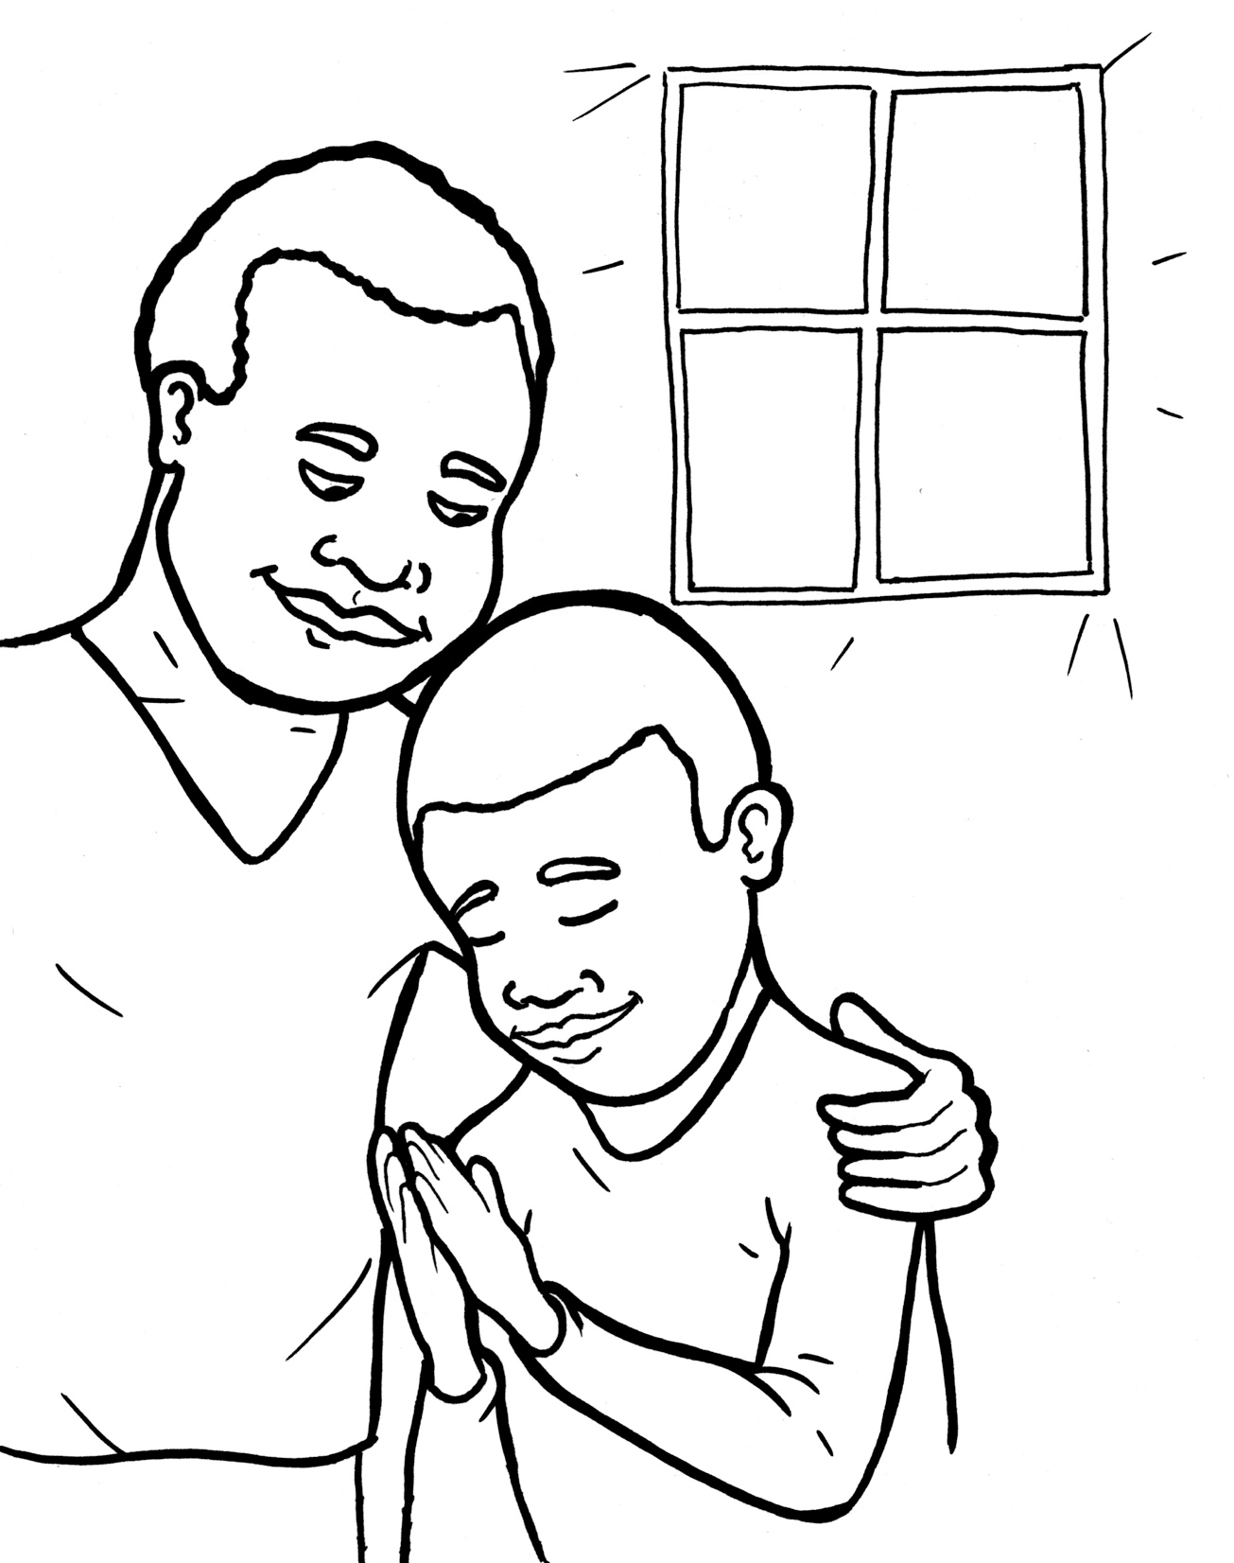

50. I am Alive: Prayer
Part 1
Syllable Charts

Slide 2
Words in Syllable Types

Slide 3
Closed – Short Vowel
A closed syllable has one vowel
followed by one or more consonants,
and the vowel is short.
st
o
p
˘

Slide 4
an -
that
fam -
hap-
pat -
- vant

Slide 5
ev-
-pens
when
-ten
yes
-men

Slide 6
in-
-il-
im
-ship
sins
this

Slide 7
of-
God
fol-
not

Slide 8
us
just

Slide 9
Open – Long Vowel
An open syllable has one vowel
with no consonant after it,
and the vowel is long.
−
go

Slide 10
a men
a ma zing

Slide 11
he we
me
re joice

Slide 12
o pens
o bey

Slide 13
by

Slide 14
sor ry
hap py
might y
ever y
famil y
honest y

Slide 15
Silent e – Long Vowel
A silent e syllable has one vowel,
followed by one consonant
and a silent e at the end.
The vowel is long.
−
ca
e
v

Slide 16
same
make

Slide 17
like
life
a live

Slide 18
Vowel Teams – Long Vowel
Many vowel teams follow this rule:
When two vowels get together,
the first one names its letter.
So the first vowel will make its long sound,
and the second vowel is silent.
−
e
a
t

Slide 19
day
pray

Slide 20
wait
praise

Slide 21
o bey

Slide 22
need
keep
sweet

Slide 23
ears
dear
hear
each

Slide 24
right
might y

Slide 25
grow
fol low

Slide 26
food

Slide 27
Vowel Teams – Other Sounds
Sometimes vowel teams make other sounds.
oil

Slide 28
how

Slide 29
our
ouch
sound
a bout

Slide 30
voice
re joice

Slide 31
good

Slide 32
breath

Slide 33
R - Controlled
R-controlled syllables have one or more vowels
followed by an “r.”
The “r” changes the sound of the vowel.
o
r
ange

Slide 34
start

Slide 35
for
or der

Slide 36
ser vant
or der
pat tern
an swers
ev er y

Slide 37
learn

Slide 38
Other Sounds – Long Vowel
These syllables or words are closed,
so the vowel should be short,
but the vowel is long.
−
cold

Slide 39
told

Slide 40
al most

Slide 41

Other Sounds – -nk/-ng
The “-nk” and “-ng”
change the sound of the vowel.
bank
thing

Slide 42
sing
king

Slide 43
longs
song

Slide 44
thank

Slide 45
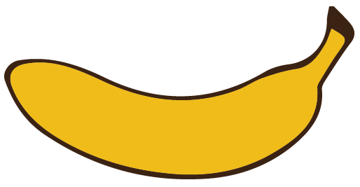
Other Sounds – schwa
The schwa syllable has an “a” that sounds
like the /u/ in banana.
The banana is even shaped like a short u.
ba nan a

Slide 46
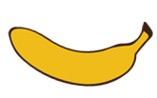
a live
a bout
a maze

